Slide 1
Digital portfolio
Student name :iswarya
Register of and nimd:asnm11324131130500122004/241311305001222004
Department :BCA
College name :113- vallalar Arts science college Annamalai university

Slide 2

Project title
Digital portfolio

Slide 3
AGENDA
Problem Satement
Projrct overview
End User
Tools and Tecnologies
Portfolio desingn and Layout
Result and Screenshot
Conclusion

Slide 4
Problem statement :
Space tourism is often seen as inaccessible and lacks
Engaging platforms the public. This project creates an interactive portfolio website using HTML, CSS, and JavaScript to simulate travel experience

Slide 5
Project overview
Designed a responsive space tourism portfolio website using HTML, CSS, and JavaScript
Showcase travel package like earth orbit, moon flyby, and mare preview
Imcludes interactive booking alerts to simulate user engagement
Features misson details and contact form with alert message
Buit as creative portfolio project to demonstrated web desig and development skils

Slide 6
End users:
Space anthusiasts curious about tourism opportunities
Recruiters or companies reviewing my portfolio project
Students and learners exploring creative web desingn ideas

Slide 7
Tools and Technology :
HTML- Strucure of the website
CSS3- Styling and responsive design
javaScript- Interactivity ad alerts
Unsplash Images-High quality space visuals

Slide 8
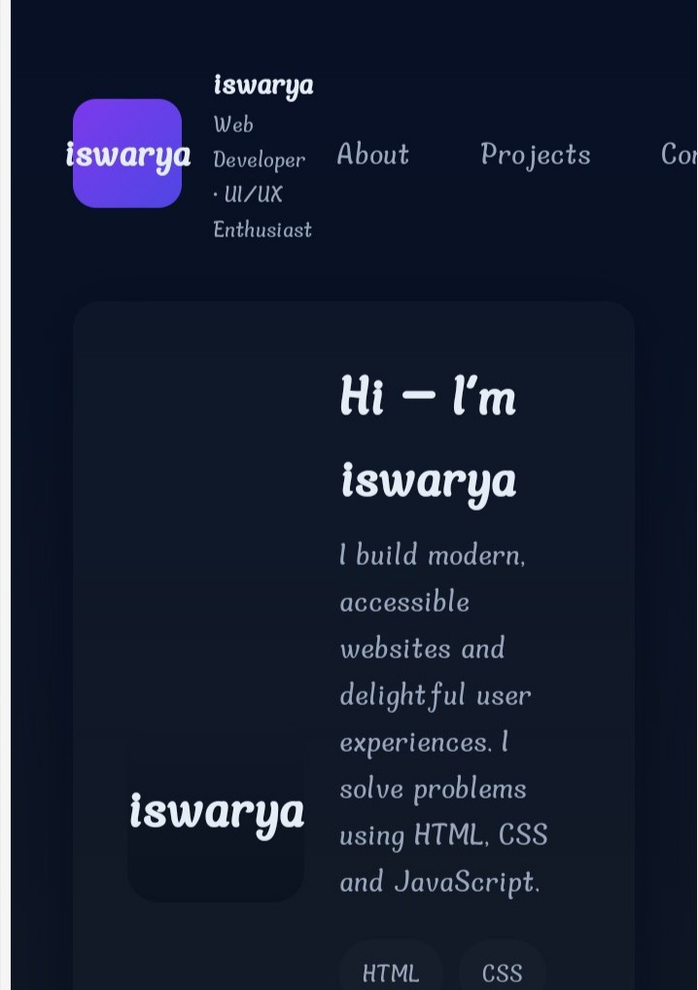
Result and Screenshot :
Buitl a responsive and interactive sapce tourism portfolio website using HTML, CSS, and JavaScript.
Showcased features like booking alerts, travel package, and contact form with aspace-themed design.

Slide 9
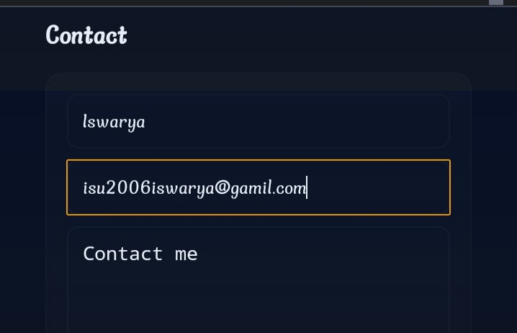

Slide 10
Conclusion :
This project demonstrated how html, css, and JavaScript can be used to design an engaging portfolio website.The space be used to design on engines tourism theme highlight creativity while showcasing interactive featured like booking alerts and contact forms. It reflects both technical skills and innovative design for portfolio presentations

